Slide 1

PRODUCT & SERVICE RANGE
BEARINGS – COUPLINGS – TAPER LOCK BUSHES
CONVEYOR IDLER FRAMES & ROLLERS
WARMAN SLURRY REPLACEMENT PUMPS & SPARES
CONVEYOR BELTS - RUBBER & PVC PLAIN & CHEVRON
VEE & WEDGE DRIVE BELTS
VALVES
VIBRATING SCREENS & FEEDERS – WIRE & POLYURETHANE
RUBBER FLANGED SUCTION & DELIVERY HOSES, HDPE & STEEL PIPES
PERSONNEL PROTECTIVE & SECURITY EQUIPMENT
Notes:
Product range

Slide 2
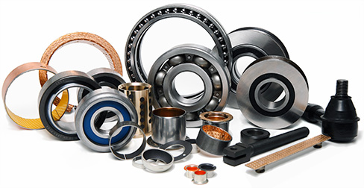
BEARINGS – COUPLINGS – T/L BUSHES

Slide 3
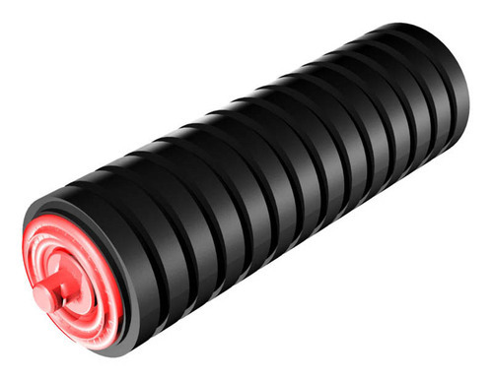
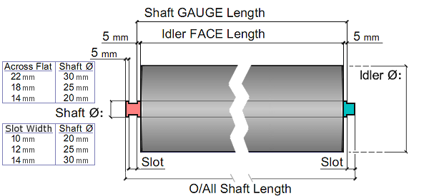
IDLER ROLLERS – STEEL AND RUBBER TROUGHING & IMPACK IDLERS Designed and manufactured to meet either standard or specific specialised applications

Slide 4
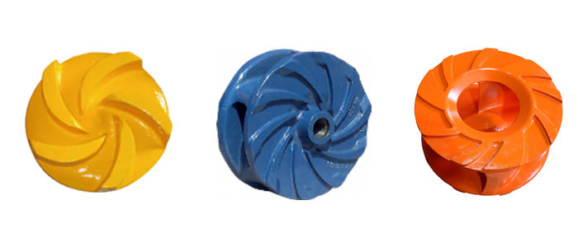
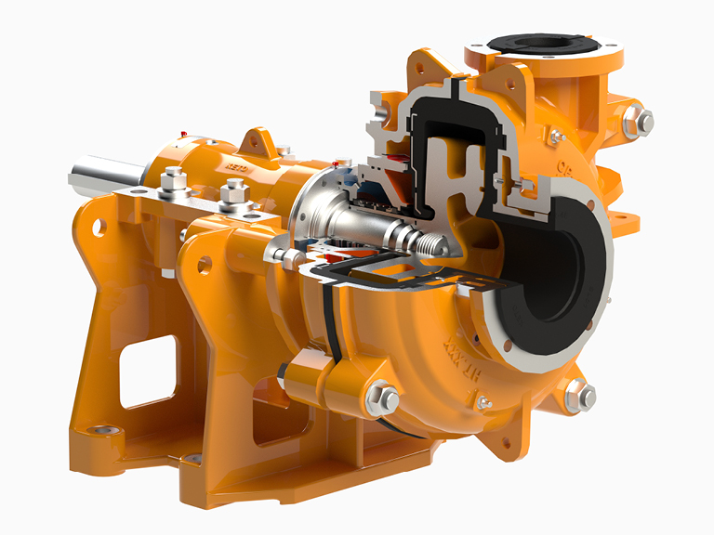
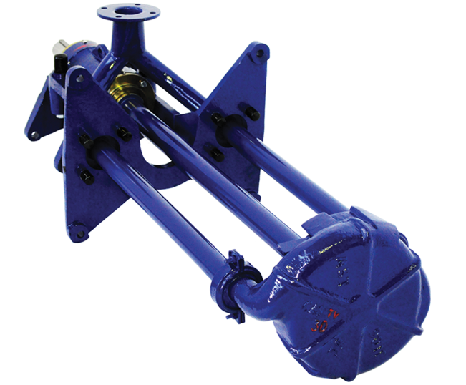
HEAVY DUTY SLURRY PUMPS - AH & CHW & DTV Metal and Rubber Range pumps and spares
Notes:
We supply a wide range of Pumps ,AH,CHW ,DTV Slurry pumps, Submersible pumps

Slide 5

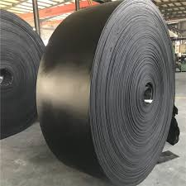
CONVEYOR BELTS STEEL CORD & TEXTILE REINFORCED – RUBBER & PVC COVERED
Rubber Covered Textile Reinforced Belts
Conveyor Belts Repair Kits – Cement & Strips & Fasteners
Notes:
We supply different types of Conveyor belts and their accessories .Grade M ,Grade N , Solid Woven belts , Chevron belts,

Slide 6
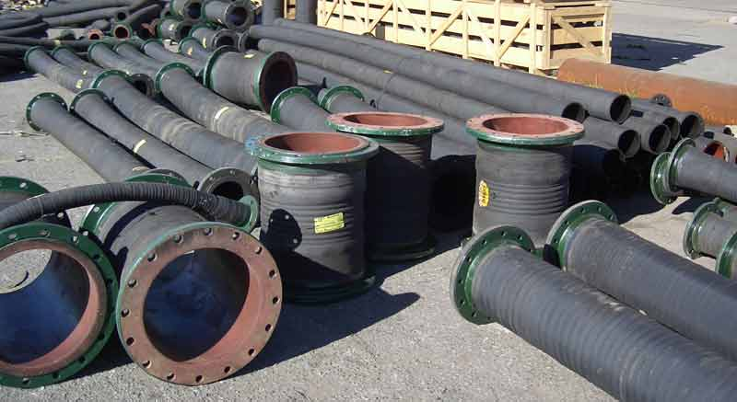
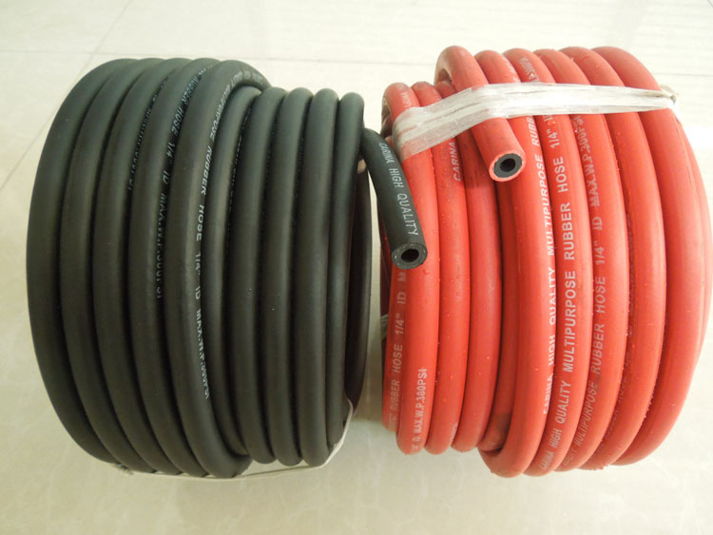
ARMOURED S&D HOSES – FBE RUBBER & PVC MINING – HYDRAULIC – LAYFLAT – COMPRESSOR HOSES
Large Bore FBE Rubber S&D Hoses
Rubber & PVC Mining Hoses
Notes:
All hose Types:-Suction and Delivery hoses , General Purpose hose , Fire hose , Ducting hoses , Braided hoses

Slide 7
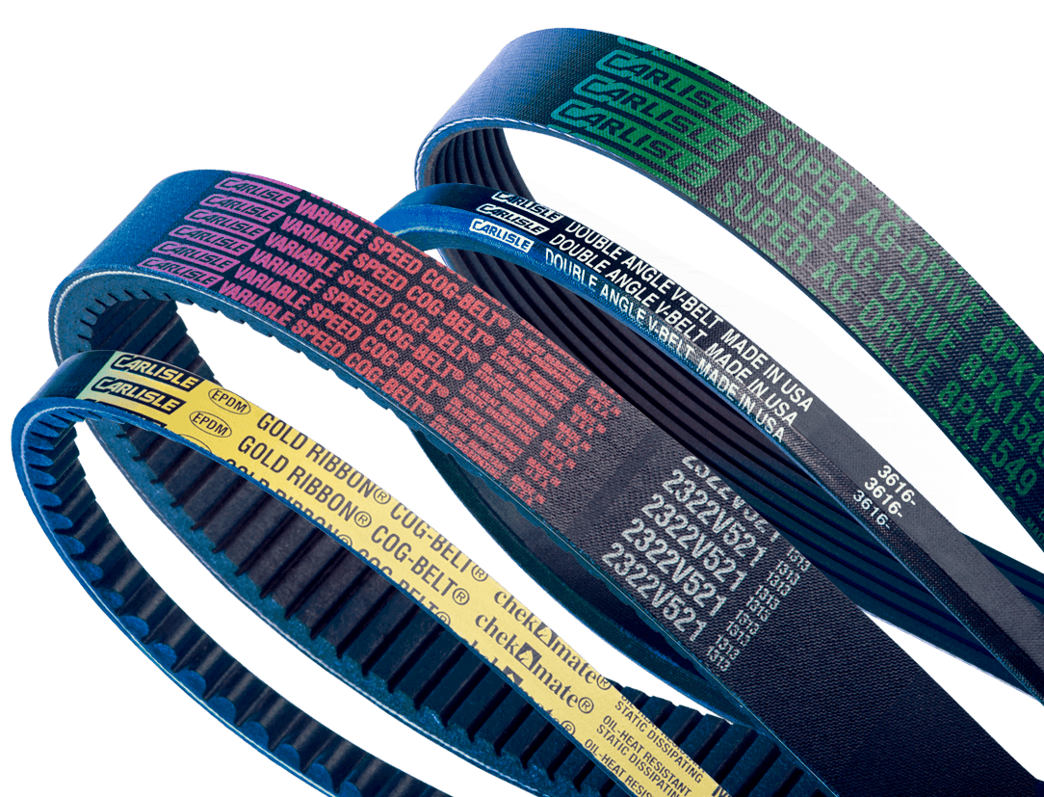
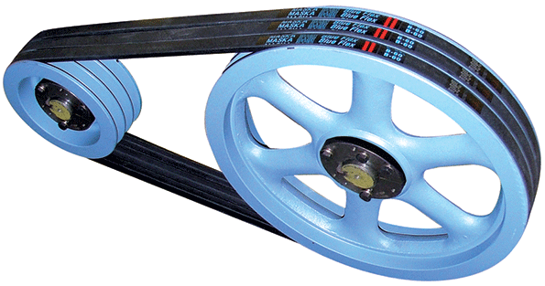
DRIVE BELTS – VEE & WEDGE
WEDGE BELTS
VEE BELTS
Notes:
V-belts

Slide 8
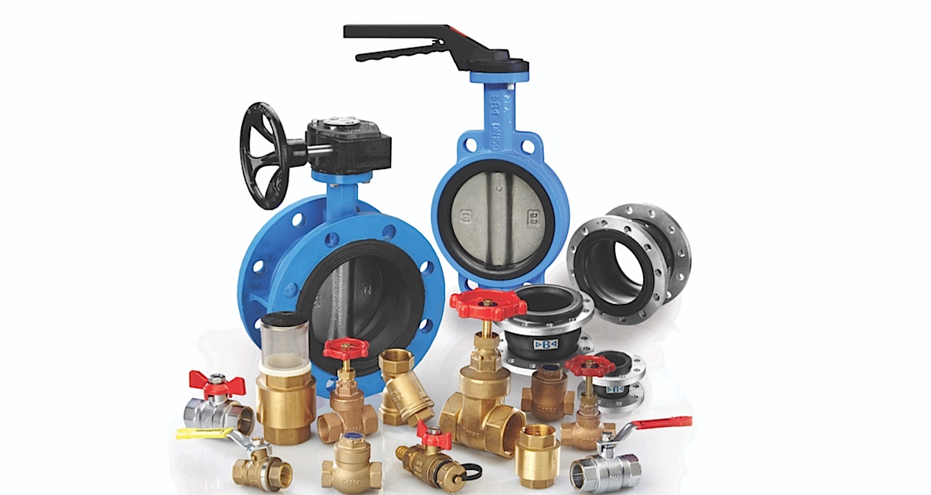
VALVES Saunders – Barrett – Gate – Ball – Pneumatic – Pressure
Notes:
Ball Bearings ,Gate Valves , Gemu Valves,Non Return Valves,Flanges etc.

Slide 9

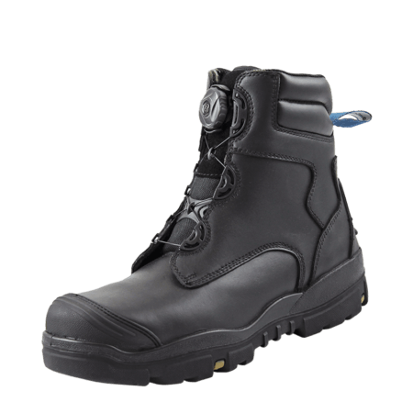
PPE & SECURITY EQUIPMENT
Notes:
Helmets,Chrome Leather Gloves,Googles,Dust Musk,Safety Shoes,Ear muffs,

Slide 10
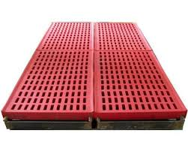
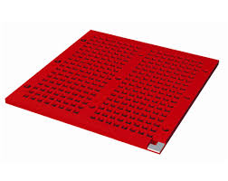
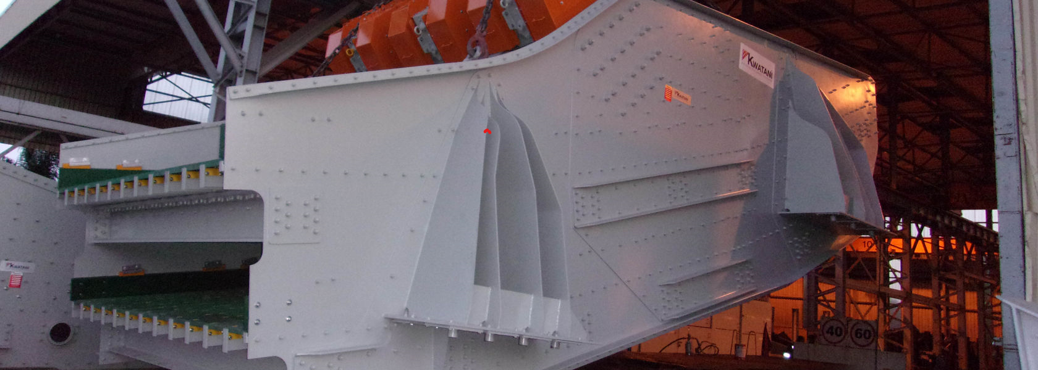
VIBRATING EQUIPMENT SOLUTIONS VIBRATING FEEDERS - SCREENS (WIRE & PU) – GEARBOXES - DRIVES Authorised country agents for KWATANI (FORMAERLY JOEST)

Slide 11
CONTACT DETAILS
NO. 6 TRAILL ROAD GODFREY GWESHE
MOUNT PLEASANT +263 773 183 834 HARARE ZIMBABWE godfrey@uniflexprojects.co.za
+263 4 301645 | 086 44221975 skype godfrey.gweshe
NO 15 FALCON LANE ED BATTES
DOUGLASDALE EXT 49 +27 63 071 7010 | 073 415 0415 (App)
SANDTON 2191 ed@uniflexprojects.co.za
SOUTH AFRICA +27 10 220 5401 | 11 071 0750
skype edward.battes
info@uniflexprojects.co.za

